Slide 1

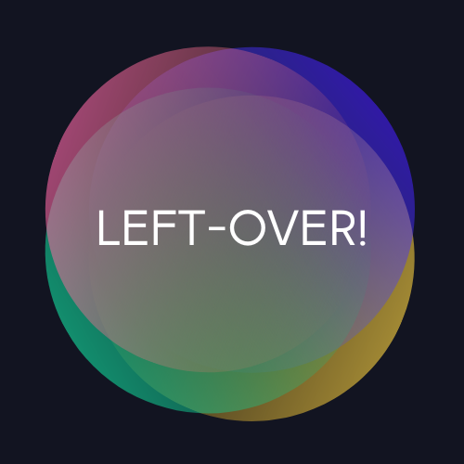
The Left-Over! app

Slide 2
The Left-Over! app is a mobile application that provides a sharing platform to make use of any kind of idle goods without price. There are three categories which are reusable, consumable and collectable. In order to enhance sustainability and increase recycling.
Display consumable and reusable items
Add and remove item
View item details
Request an item
Messaging between sharer and recipient
Display the closest drop points on the map

Slide 3
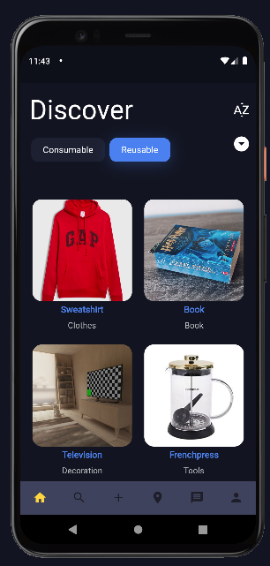
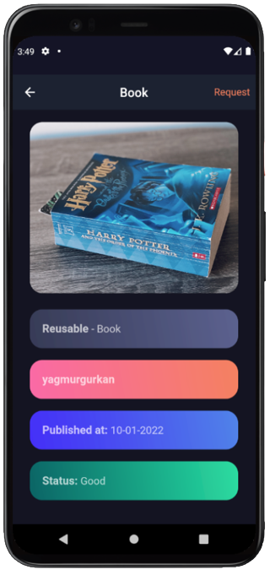
Discover Items and Display Details

Slide 4
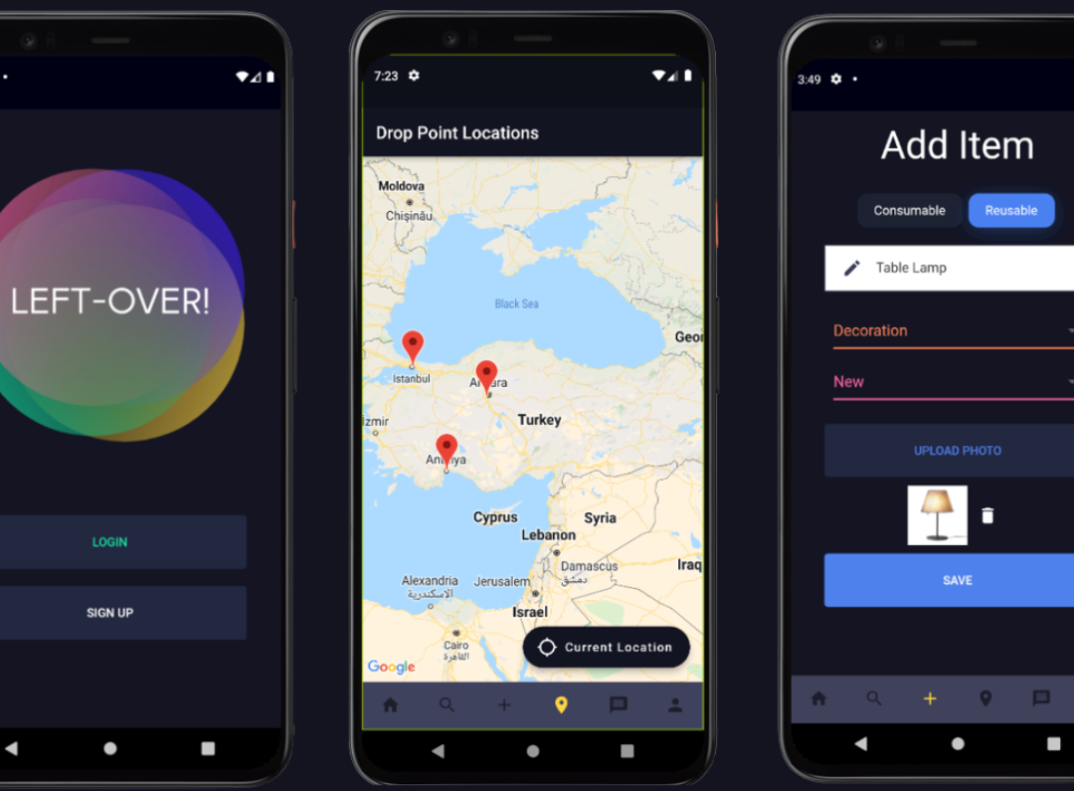

Slide 5
Left-Over! App Developed by:
Furkan Kılıç
Mehmet Melikşah Özceyhan
Nevin Didem Bilgihan
Yağmur Cansu Gürkan
Advisor: Neşe Şahin Özçelik

